Slide 1




March 27, 2020
3

Slide 2
Agenda: MSBI.Dev.PowerBI.S20E01
1. Power BI Desktop Data Transformations
Transforming Data using Power BI Desktop
· Introduction to Power BI Desktop
· Changing Locale
· Connecting to a Database
· Basic Transformations
· Managing Query Groups
· Splitting Columns
· Changing Data Types
· Working with Dates
· Removing and Reordering Columns
· Conditional Columns
· Connecting to Files in a Folder
· Merge Queries
· Query Dependency View
· Transforming Less Structured Data
· Enter Data
· Query Parameters
3

Slide 3
Plan: MSBI.Dev.PowerBI.S20E01
1. Introduction - 5 min
1.1. About course.
1.2. Installation.
2. Theory part - 35 min
2.1 Overview of Power BI Desktop and Power BI service.
2.2 Areas: Report, Data, Model
2.3 Dataset upload
2.4 Transformation window: queries, applied steps
2.5 Enter data
2.6 Base transformations:
Change data type
Date type
Duplicate column
Append query
Split column
Delete column
Add column: Custom. Column From Examples, Conditional Column
Get data from folder
Merge queries
2.7 Groups, query dependencies
2.8 Upload from folders
2.9 Other transformations:
Transpose
Pivot-unpivot
2.10 Query parameters
3. Practice - 20 min
4. Summary - 5min
3
Notes:
DB:
EPRUSARW1944
PowerBI2020
Source:
(year as number) as table =>
let
Source = Web.BrowserContents("https://www.numbeo.com/quality-of-life/rankings.jsp?title="&Number.ToText(year)),
Location:
1) var = Table.Distinct(FactQualityOfLife,"City") as table
2) var
let
Source = Table.Distinct(GetDataByYear(2019), "City"),

Slide 4
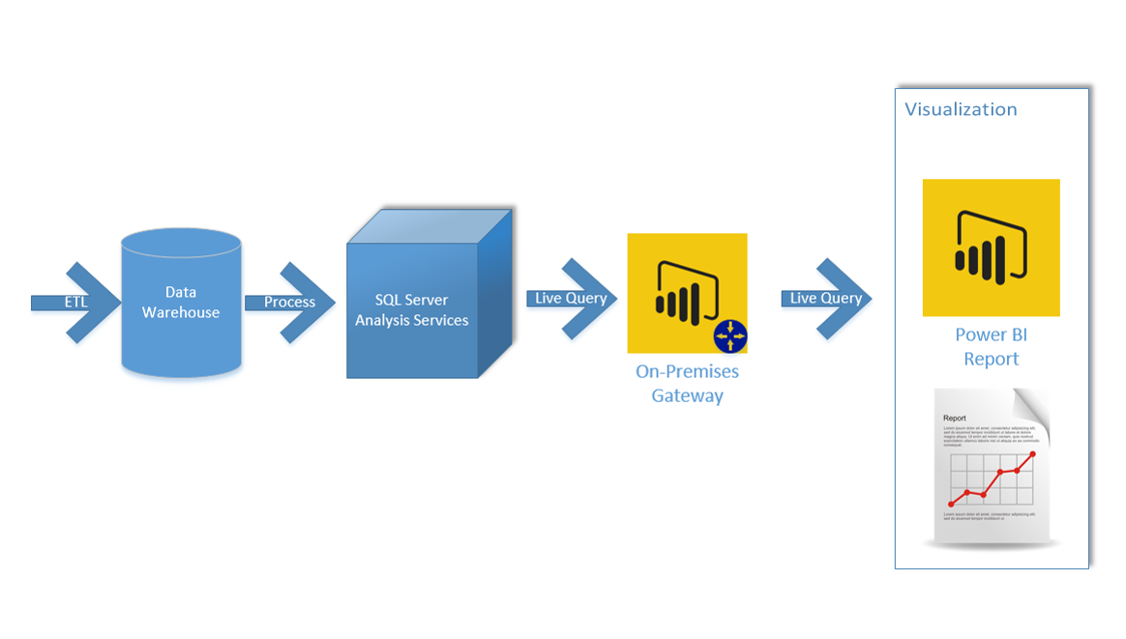
Enterprise Architecture for Power BI
3

Slide 5
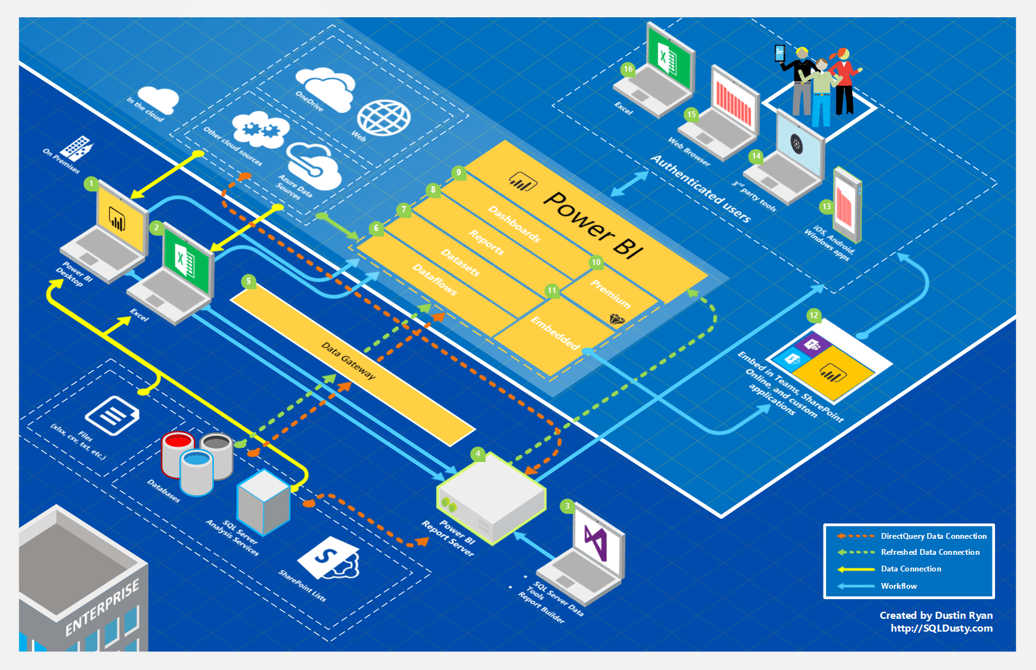
Global Architecture for Power BI
3

